Slide 1

CREDIT CARD WEEKLY STATUS REPORT

Slide 2

Project Objective :
To develop a comprehensive credit
card weekly dashboard that
provides real-time insights into key
performance metrics and trends,
enabling stakeholders to monitor
and analyze credit card operations
effectively.

Slide 3

Project Insights- Week 53 (31st Dec)
WoW change:
• Revenue increased by 28.8%,
• Total Transaction Amt & Count increased by 35% & 3%
• Customer count increased by 12%
Overview YTD:
• Overall revenue is 57M
• Total interest is 8M
• Total transaction amount is 46M
• Male customers are contributing more in revenue 31M, female 26M
• Blue & Silver credit card are contributing to 93% of overall
transactions
• TX, NY & CA is contributing to 68%
• Overall Activation rate is 57.5%
• Overall Delinquent rate is 6.06%

Slide 4
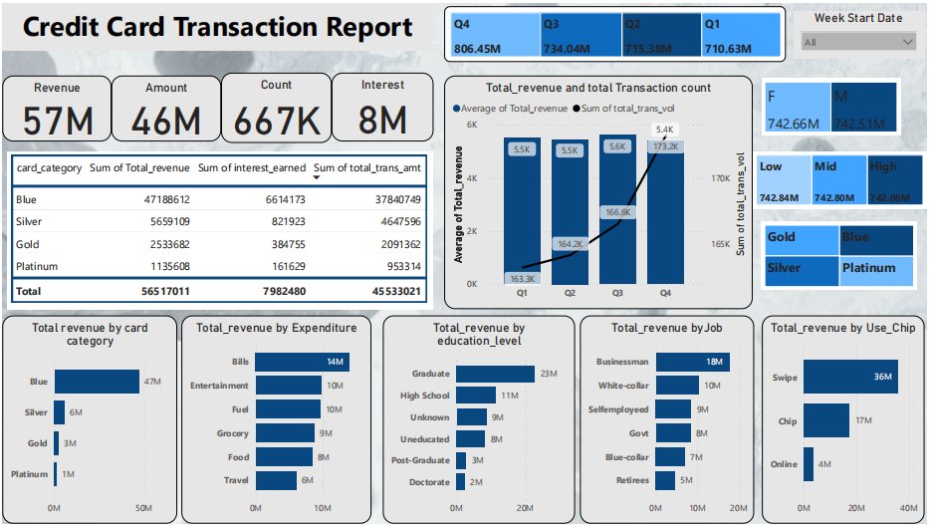

Slide 5
